Slide 1

TECHNICAL PROJECT
CSA1405: Compiler Design
Phases Of Compiler and Their Roles
UNDER THE GUIDANCE OF:
Dr.S.SIVAGAMI
PRESENTED BY:
SUDHARSAN D -(192524063)

Slide 2
Introduction
Compiler converts source code into machine code.
Compilation is performed in multiple phases.
Each phase has a specific role.
Detects and reports program errors.
Improves code efficiency through optimization.
Generates executable machine code.

Slide 3
Lexical Analysis
First phase of the compiler. Converts source code into tokens.
Removes unnecessary spaces, tabs, and comments.
Identifies keywords, identifiers, operators, and constants.
Uses Lexical Analyzer (LEX) for token recognition.
Sends tokens to the next phase (Syntax Analysis).

Slide 4
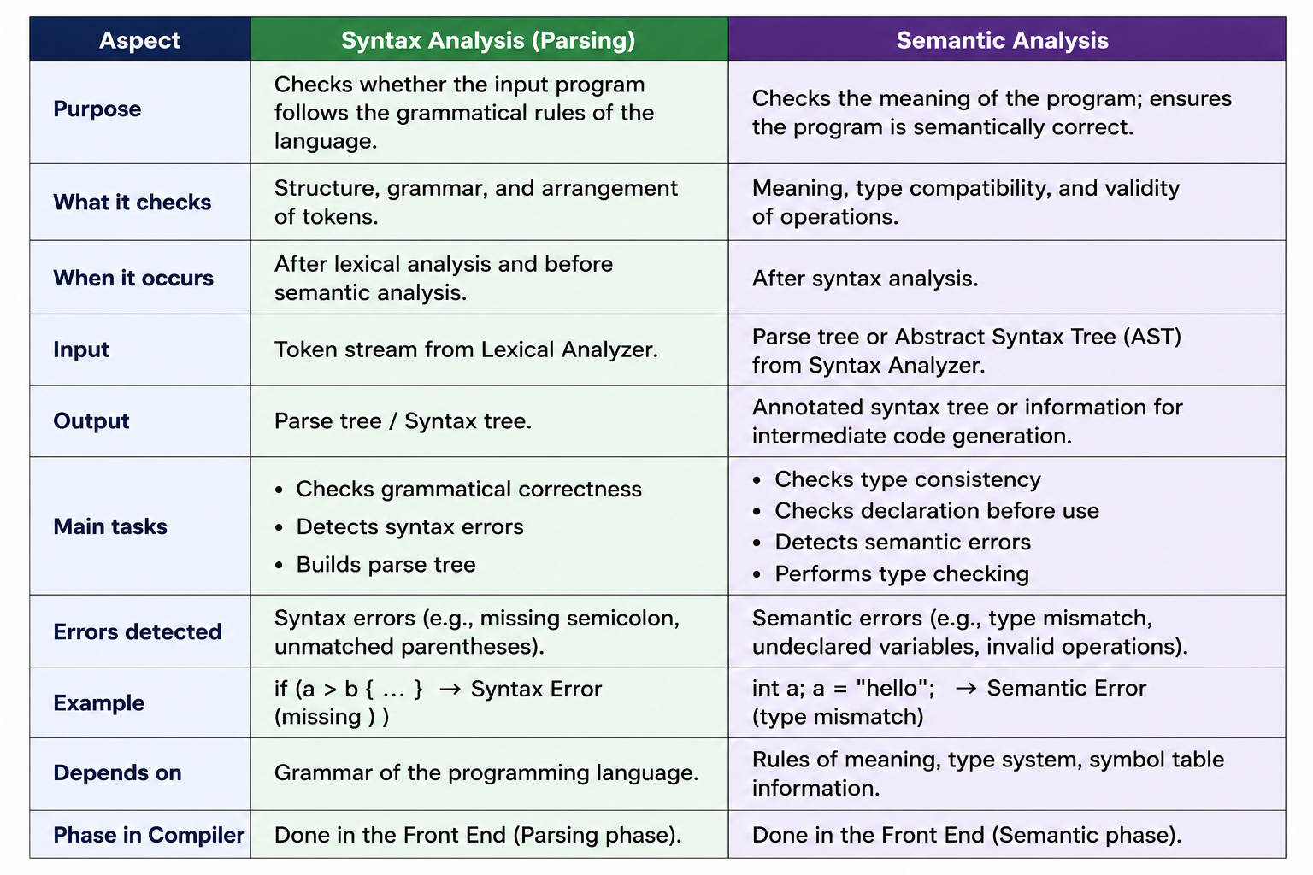
Syntax and Semantic Analysis

Slide 5
Conclusion
Compiler converts source code into machine code.
Each compiler phase has a specific role.
Syntax analysis checks grammar.
Semantic analysis checks meaning and correctness.
Code generation produces executable machine code.
All phases work together for efficient program execution.

Slide 6


